Slide 1

Introduction to Programming Lecture 05 Mr. Niaz Mir Khan Lecturer in Computer Science ____________________________________________________________________
Department of Computer Science
Govt: Degree College Jamrud, District Khyber

Slide 2
Control Structures
Control Structures are just a way to specify flow of control in programs. C++ provides control flow statements, also called flow control statements, which allows the programmer to control the sequence of execution of statements of a program by the processor. The most commonly used control flow statements are decision, repetitions and compound statements.
Decision Statements
Decision statements are used in programming to make decisions based on certain conditions. They allow a program to choose different actions based on whether a condition is true or false.

Slide 3
.
The most common types of decision statements are:
If-statement: Executes a block of code if a condition is true.
If-else statement: Executes one block of code if the condition true, and another block if the condition is false.
Switch statement: The switch statement is used to simplify complex conditional logic when comparing a variable against multiple possible values (cases).
It is useful for: Handling multiple conditions, Improving performance

Slide 4
IF Statement
If statement is the most simple decision-making statement. It is used to decide whether a certain statement or block of statements will be executed or not i.e., if a certain condition is true then a block of statement is executed otherwise not. The general syntax of an if statement is given below.
For single statement If Structure
if(condition)
Statement;
For multiple statements If Structure
if(condition)
{
Statement 1;
Statement 2;
}

Slide 5
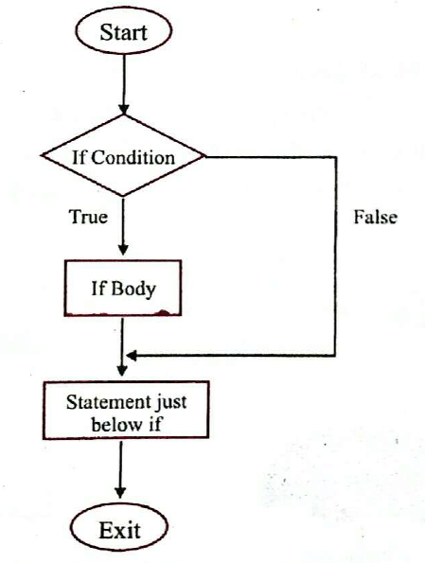
Working of if Statement

Slide 6
C++ code example to demonstrate the if statement:
int main()
{
int x;
cout<<“Enter a number”<<endl;
cin>>x;
if(x%2==0)
cout<<x<<“ is even number”<<endl;
return 0;
}

Slide 7
If-else Statement
The if-else statement allows a program to make decisions based on a condition. It works like a simple choice:
If the condition is true, the program will execute the code inside the if block.
Else if the condition is false, the program will execute the code inside the else block.
If-else makes programs interactive by reacting to different situations.
Also helps in decision-making based on conditions. The general syntax of an if-else statement is given below.
If (condition)
Statement;
else
Statement;

Slide 8
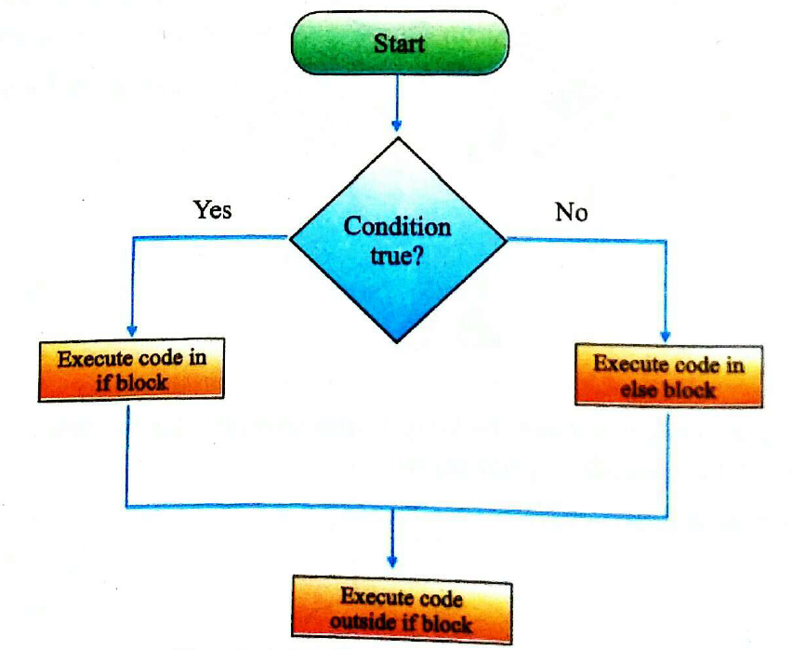
Working of if-else Statements

Slide 9
C++ code example to demonstrate the if-else statements:
int main()
{
int age;
cout<<“Enter you age”<<endl;
cin>>age;
if (age >= 18) {
cout<<“you are an adult”<<endl;
}
else {
cout<<“You are a minor”<<endl;
}
return 0;
}

Slide 10
switch-default Statement
Normally, if we have to choose one case among many choices, nested if-else is used. But, if the number of choices is large, switch-case is a better option as it makes our code more neat and easier.
The main purpose of switch statement is to check several possible choices and then execute only those which match the particular case value. Its general syntax is given below.
switch(expression)
{
case constant1:
statement(s);
break;
- - - - - -
- - - - - -
default:
statement(s);
}

Slide 11
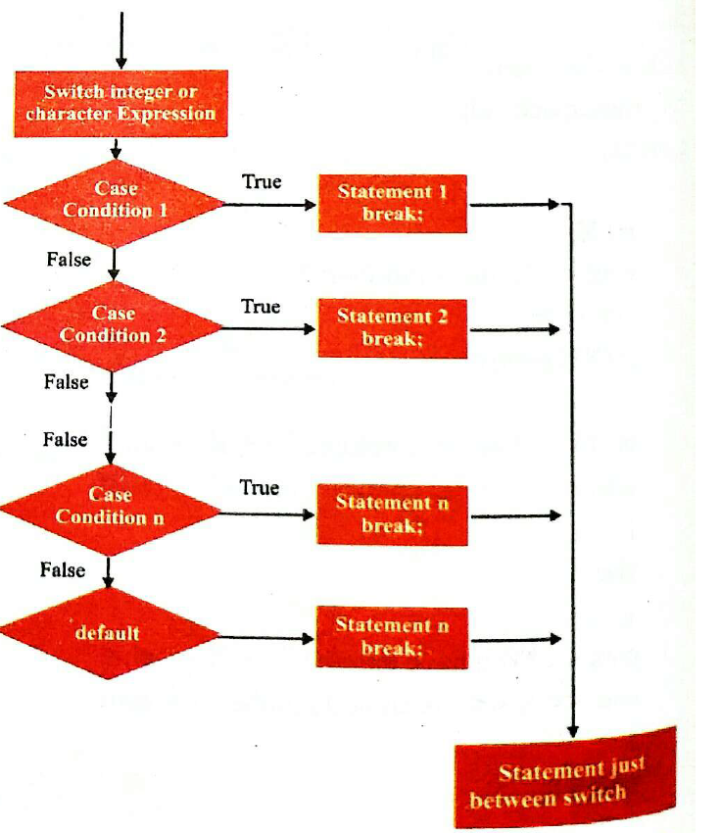
Working of switch Structure

Slide 12
C++ code example to demonstrate the switch Structure:
int main()
{ char grade = ‘B’;
switch(grade)
{ case ‘A’:
cout<<“Excellent !”<<endl;
break;
case ‘B’:
cout<<“Outstanding !”<<endl;
break;
default:
cout<<“Invalid grade”<<endl;
}
return 0;
}

Slide 13
Nested-if Statement
A nested-if is an if-statement that is enclosed in another if-statement. C++ language allows programmers to use an if-statements within another if-statement. The general syntax of nested-if statement is:
if(condition1)
{
//Executes when condition1 is true
if(condition2)
{
//Executes when condition2 is true
}
}

Slide 14
Working of nested-if Structure
Start
.
If Condition
Nested-If Condition
True
False
False
True
Else Body
Nested-if Body
Nested-else Body
Statements just below nested-if Structure
Exit

Slide 15
C++ code example to demonstrate the Nested-if Structure:
int x;
cout<<“Enter a number”;
cin>>x;
if(x > 50)
{ if(x > 100)
cout<<x<<“is greater than 100”<<endl;
else
cout<<x<<“is between 50 and 100”<<endl;
}
else
cout<<x<<“is less than 50”<<endl;
return 0;
}

Slide 16
Break Statement & exit() Function
Sometimes a programmer needs to make use of such statements in a program that are responsible for the jump from one statement of the program to another statement. The most commonly used jump statements of C++ language are: goto, break and continue. Similarly, the execution of a running program is also sometimes needed to be halt and to jump out of a program. A function used to accomplish this is exit().
Break Statement
break statement is used to make jump from one part of the program to another. In C++, break statement is used in two situations: one in switch-default structure to properly end a case clause and another in loops structure to leave a loop even. Actually, break statements are used in the situation where the actual number of iterations not known or we want to terminate the loop based on some condition. Code of break statement has already been discussed in the previous slides.

Slide 17
exit() function
exit() function tells the program to quit running immediately. This function is responsible for the immediate termination of a C++ program. It is defined in stdlib header file. The exit function takes an integer, usually 0, as a parameter that is returned to the operating system as an exit code and tells it that the program has terminated normally. Example of exit() function using C++ code:
int main()
{
cout<<“Statement before exit() function”;
exit(0); // terminate and return 0 to the operating system
// the following statements never execute
cout<<“Statement after exit() function”;
return 0;
}

Slide 18
Loops
A loop is used for executing single statement or a block of statements repeatedly until a particular condition is satisfied. Loops are also called repetitive or iterative statements. For example, when you are displaying “I love Pakistan” 100 times on screen, then it can be easily accomplished through the use of loop. In C++ we have three types of basic loops:
for, While and Do-while
for loop: The most commonly used looping structure in C++ is for loop. for loop is ideal in situation when we know in advance the exact number of iterations. Its general syntax is:
for(initialization; condition; increment/decrement)
{ Statement 1;
Statement 2;
…
Statement n;
}

Slide 19
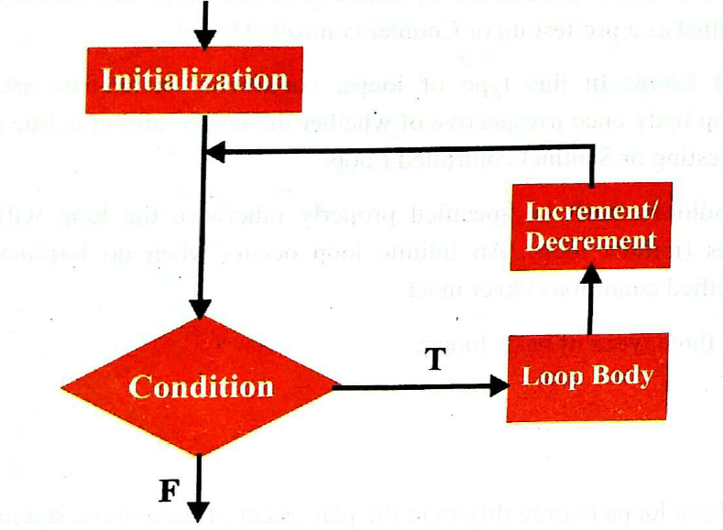
Working of for-loop

Slide 20
.
Initialization:
Generally it is an initial value setting for a counter variable. This is executed only once.
Condition:
If it is true, the loop continues, otherwise the loop body is skipped (not executed) and loop ends.
Increment/Decrement:
It increment or decrement the value of variable by one.
Loop Body:
It can either be a single statement or a block of statement enclosed in braces {}, for multiple statements.

Slide 21
Example of for loop using C++ code:
int main()
{
for(int i = 1; i < 6; i++)
cout<<“I Love Pakistan”<<endl;
return 0;
}
An example of countdown using for loop:
int main()
{
for(int n = 10; n > 0; n--)
cout<<n<<“ “;
return 0;
}

Slide 22
b. while Loop
The while loop specifies that a program should repeat set of instructions inside the block till the condition remains true. While loop used in place where we don’t know number of iterations in advance and it depends on the update (increment/decrement) inside the block. While loop is pre-tested loop. Its general syntax is given below.
while(condition)
{
Statement 1;
Statement 2;
…
Statement n;
}

Slide 23
Working of while loop
.
Condition
True
Loop Body
False

Slide 24
Example of while loop using C++ code:
int main()
{
int num = 1; //initializing the variable
while(num <= 5) // while loop with test condition
{
cout<<num<<“ “;
num++; // incrementing (update condition)
}
return 0;
}

Slide 25
c. do-while loop
do-while loop is almost similar to the while loop except that the body of a loop is executed once, before test condition is evaluated. It is post-tested loop. The execution of do-while loop, guaranties the execution of the statement in its body, at least once, even if the condition is false. The general syntax of do-while loop is as follows:
do
{
Statement(s)
}
While(test condition);

Slide 26
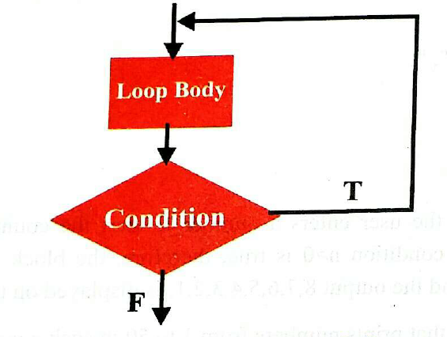
Working of do-while loop

Slide 27
Example of do-while loop using C++ code:
int main()
{
int num = 6; //initializing the variable
do
{
cout<<num;
num++; //incrementing (update expression)
}
while(num<=5);
return 0;
}

Slide 28
Nested Loops
A loop inside the body of another loop is called nested loop. The enclosing loop is called outer loop and the enclosed loop is called inner loop. For each iteration of the outer loop, the inner loop repeats its entire cycle. The general syntax of nested loop is given below:
for(initialization; condition; increment/decrement) //outer loop
{
for(initialization; condition; increment/decrement) //inner loop
{
statement…. // body of inner loop
}
statement….. // body of outer loop
}

Slide 29
Example of do-while loop using C++ code:
int main()
{
int i, j;
for(i = 1; i <= 3; i++) //outer loop
{
for(j = 1; j <= 5; j++) //inner loop
{
cout<<i<<“x”<<j<<“=“<<i*j<<endl;
}
cout<<endl;
}
return 0;
}

Slide 30
Continue Statement
The continue statement provides a convenient way to jump to the start of a next iteration ignoring the remaining part of the loop for an iteration. For example, we are going to skip the number 5 in our countdown:
int main()
{
for(int n=10; n>0; n--)
{
if(n==5) continue;
cout<<n<<“,”;
}
return 0;
}

